Slide 1
By:eng.khder Ahmed software engineering& Back-End developer
An intelligent, all-in-one platform for automating fleet logistics, tracking routes, and reducing operational costs

Slide 2
1-Product & Developer Branding
Layout: Hero Section with Dark Glassmorphism Container and Stack Badges.
Title: DeliveryRouter
Subtitle: High-Performance Enterprise Fleet & Logistics Optimization Platform
Tagline: Microservice-driven route optimization, real-time spatial tracking, and granular fleet payload management.
Tech Stack Pill Badges: Laravel 12 | Python FastAPI | Docker Compose | Livewire 3 | Redis | Leaflet.js
Engineer Info:
  Khder Jaber Ahmed — Backend & Software Engineer
  Specialization: PHP/Laravel, Python Microservices, System Architecture

Slide 3
2-The Engineering Problem & Solution Matrix
Legacy Monolithic Approach (The Bottleneck) | DeliveryRouter Architecture (The Solution)
High Latency: Synchronous $O(N^2)$ VRP route calculations freeze HTTP workers. | Asynchronous Decoupling: Heavy routing algorithms offloaded to a dedicated Python engine.
Monolithic Overload: Single-threaded PHP processes struggle under spatial computation. | FastAPI Microservice: Asynchronous ASGI service handling distance matrix execution.
Unoptimized Payloads: Lack of dynamic payload validation leads to overloaded fleets. | Strict Capacity Constraints: Real-time payload math (max_weight_kg) preventing fleet overload.
Full Page Reloads: Slow GIS map re-renders disrupt dispatch operations. | Reactive Client-Side GIS: Livewire 3 + Alpine.js with Leaflet.js canvas updates without page reloads.

Slide 4
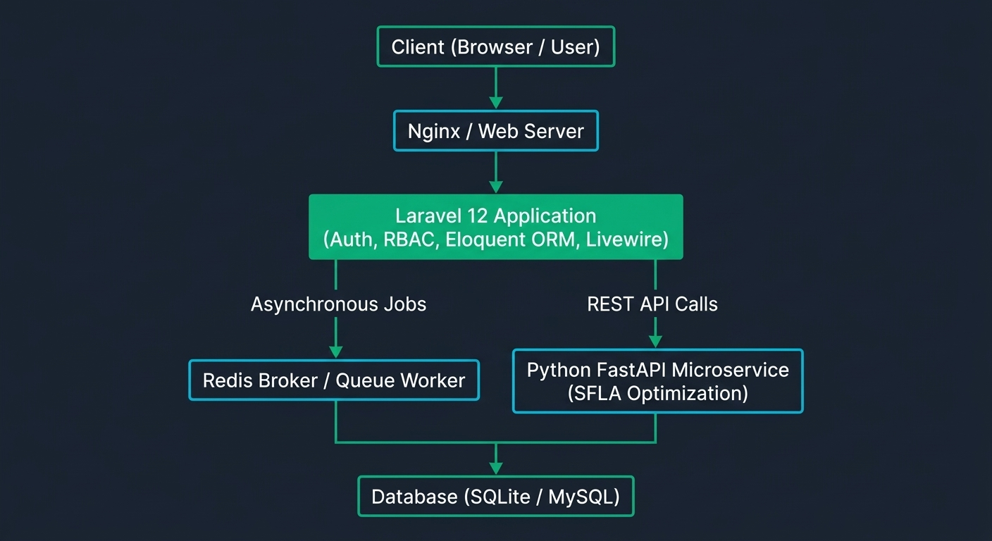
3-Microservice Architecture & Data Flow

Slide 5
Core Architectural Pillars:
Laravel 12 Domain Core: Handles RBAC, business logic, session security, and state mutations.
FastAPI Optimization Engine: Executes the Shuffled Frog Leaping Algorithm (SFLA) for dynamic Vehicle Routing Problems (VRP).
Redis Event Queue: Manages asynchronous background job processing, preserving sub-50ms HTTP response cycles.
Isolated Docker Stack: Multi-container orchestration via Docker Compose (laravel_app, fastapi_app, redis) on a private bridge network.

Slide 6
4-Production Core Modules
Layout: 2x3 Feature Card Grid with Icons and Micro-Highlights.
Analytics Dashboard:
  Real-time fleet state tracking & KPI monitoring via Chart.js.
  Non-blocking background polling (wire:poll.10s).
Order Lifecycle Engine:
  Strict finite state machine (Pending $\rightarrow$ Dispatched $\rightarrow$ Delivered).
  Spatial coordinate indexing (Latitude, Longitude) and parcel weight validation.
GIS Route Planner:
  Leaflet.js and OpenStreetMap integration mapping active depots, vehicles, and destinations.
  Distance-matrix generation and payload distribution.
Fleet Capacity Controller:
  Dynamic vehicle state switching (Available, On Route, Maintenance).
  Payload weight bounds enforcement before dispatch.
Dispatch Hub Manager:
  Central warehouse and distribution node configuration.
  Spatial grouping of orders based on proximity heuristics.

Slide 7
4-Production Core Modules
Granular RBAC Security:
Role-Based Access Control enforcing Admin, Manager, Driver, and Customer privileges.
Isolated per-user state mutation handlers (updateRole(userId, newRole)).

Slide 8
5-Performance, Security & DevOps Engineering
Defensive Application Security:
Rate-limiting middleware on auth routes mitigating Brute-Force attacks.
Enforced encrypted HTTP-Only session cookies with strict CSRF protection.
Database & Query Optimization:
Eager loading on Eloquent relationships eliminating $N+1$ query overhead.
Optimized spatial indexing for high-frequency geolocation lookups.
Containerization & Fail-Safe Design:
Clean separation of concerns with environment-isolated Docker containers.
Circuit breaker patterns for seamless API communications between PHP and Python.

Slide 9
6-Repository & Call to Action (CTA)
ash
https://github.com/KhderAhmed/Better-route-tracking-system
cd Better-route-tracking-system
docker compose up --build -d
Status: Open for Software Engineering / Senior Backend Roles
Contact: Reach out on LinkedIn for full technical discussions & code walkthroughs.

